Slide 1
11/13/24
Distance Education Effectiveness Reporting
TEXAS A&M UNIVERSITY
Office of Institutional Effectiveness & Evaluation

Slide 2
Agenda
DE Effectiveness at Texas A&M
Dr. Kelley Shaffer, Director of Distance & Digital Education
23-24 DE Program Effectiveness reporting – Fall 2024
Sources of Data
– SCEs: Mr. Michael Alexander, Asst Dean for Grad Programs at Mays Business School
Introduction to OLC Framework
Future Reporting & Resources

Slide 3
Objectives
COMPARE/CONTRAST the DE Program Effectiveness review and the Academic Program Assessment process in terms of purpose, scope, and reporting process.
IDENTIFY multiple sources of data that provide evidence of DE effectiveness and a foundation for developing programmatic improvements/enhancements.
IDENTIFY methods for comparing DE data to those of traditional offerings.
LOCATE resources and additional information about this process and about online program administration in general.

Slide 4
DE Program Effectiveness @ Texas A&M
BACKGROUND & PURPOSE
Online education still relatively new; important to assess learning and program outcomes in these modalities.
Current reporting process--developed in response to Guidelines for the Evaluation of Distance Education (SACSCOC). In alignment with THECB and DoE mandates.
Purpose is NOT to question program content/teaching –documentation provides evidence of participation
“
The institution evaluates the effectiveness of its online learning…and uses the results of its evaluations to enhance the attainment of the goals.”
- Guidelines for the Evaluation of Distance Education, SACSCOC Executive Committee, March 2020
UNIVERSITY’S FOCUS
Quality of online course delivery
More meaningful utilization of data to continually improve online education
Broader support of faculty and students engaged in online education

Slide 5
External Considerations for
Distance Education

Slide 6
Accrediting Body
State Governing Body
Federal Governing Body

Slide 7
Texas Higher Education Coordinating Board (THECB)
Institutional Plan for Distance Education
Report we must complete that addresses how we are meeting the Principles of Good Practice (PGP) for distance education

Slide 8
Principles of Good Practice (PGP)
Evaluation and Assessment
Assessment of student learning follows processes used in onsite courses or programs and/or reflects good practice in assessment methods. (C-RAC, QM, SACSCOC)
Student course evaluations are routinely taken, and an analysis of them contributes to strategies for course improvements. (C-RAC, SACSCOC, SC)
The institution regularly evaluates the effectiveness of the academic and support services provided to students in distance education courses and uses the results for improvement. (C-RAC, SACSCOC, SC)
Notes:
C-RAC: Council of Regional Accreditation Commissions
SACSCOC: Southern Association of Colleges and Schools Commission on Colleges
SC: The Online Learning Consortium (OLC) Quality Score Card

Slide 9
Principles of Good Practice (PGP)
Evaluation and Assessment (cont.)
The institution documents its success in implementing changes informed by its programs of assessment and evaluation. (C-RAC, SACSCOC)
The institution sets appropriate goals for the retention/persistence of students using distance education, assesses its achievement of these goals, and uses the results for improvement. (C-RAC, SACSCOC)
If faculty roles are distributed, evaluation strategies ensure effective communication between faculty members who design curriculum, faculty members to interact with students, and faculty members who evaluate student learning. (C-RAC, SACSCOC)

Slide 10
Principles of Good Practice (PGP)
Evaluation and Assessment (cont.)
The institution uses examples of student work and student interactions among themselves and with faculty in assessing program learning outcomes. (C-RAC, SACSCOC)

Slide 11
The University’s LMS
Benefits of Canvas (all modalities)
Student submissions are stored in perpetuity.
Student submissions are stored behind our firewall ensuring security.
Has a Rubrics feature that can aid with grading consistency.
Has an Outcomes feature that can aid with collecting data for assessment purposes and for outside accreditation organizations.
Is fully supported with technical support and training.

Slide 12
Program Assessment & DE Program Effectiveness
Similarities:
Same dual-phase reporting (PA: Plan/Report, DE: Sources of Data/Findings & Implications)
Same general timeline (Spring planning, Fall reporting)
Both should be self-contained, standalone reports
Differences*:
Academic Program Assessment | DE Program Effectiveness
Focus on PLOs (direct measures) | PLOs (direct/indirect), student experience & success metrics (SCEs, surveys, GPR, graduation/retention, etc.)
9-step workflow | 6-step workflow
College-level & OIEE feedback steps | OIEE feedback only
*May have different Program Coordinators assigned in HelioCampus

Slide 13
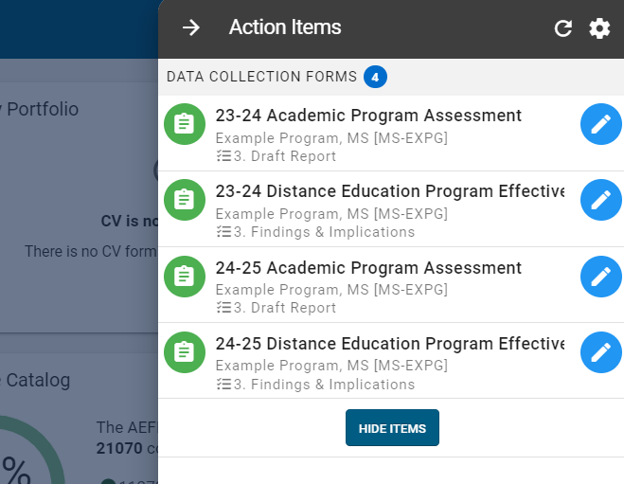
23-24 DE Reports
Findings & Implications
Due Date: December 6
--Submit to Step 4 in HelioCampus

Slide 14
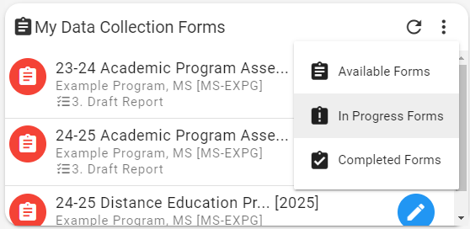
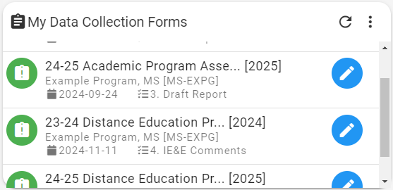
23-24 DE Report – Where is it?
In the form:
Who has worked in this form and when?

Slide 15
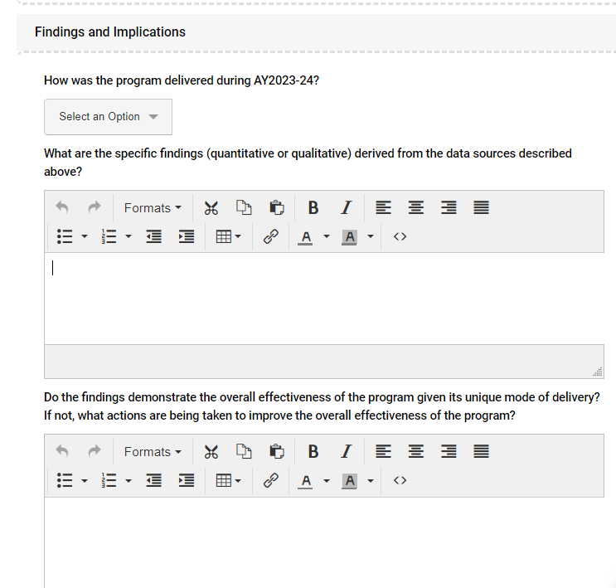
23-24 DE Reports
#1
#1: Mode of delivery selection
#2: Findings - address all sources of data described above (FTF comparison data where possible)
#3: Continuous improvement
Tips:
Re-read the feedback at the bottom of the form
Use the Form History to refresh your memory/see who has worked in the form
OIEE reviews reports in January
#2
#3

Slide 16
Sources of Data
PLOs
Mirror the Findings in Academic Program Assessment report
Student perspective of their own learning (surveys/SCEs)
STUDENT SUCCESS
Retention/graduation rates
Time to graduation
GPA
Key course performance
SCEs
STUDENT FEEDBACK
Exit/graduation surveys
Interviews/focus groups
SCEs
DE program data should be compared to data from traditional offerings.

Slide 17
Comparing to FTF Offerings
Reasonable comparator in same department
Typically same degree level
Similar student demographics
Overlap in foundational knowledge/key coursework
Same credential in FTF modality
“Built-in” comparator
Should have PLOs in common
Multiple comparators
Flexibility
Depending on the sources of data, may make sense to compare to Program A on X metric, and to Program B on Y metric.

Slide 18
Sources of Data
PLOs
Mirror the Findings in Academic Program Assessment report
Student perspective (surveys/SCEs)
STUDENT SUCCESS
Retention/graduation rates
Time to graduation
GPR
Key course performance
SCEs
STUDENT FEEDBACK
Exit/graduation surveys
Interviews/focus groups
SCEs
DE program data should be compared to those of traditional offerings.

Slide 19
Student Course Evaluations (SCEs)
SCE data from key courses – aggregate up (program level)
What does the program want/need to know most?
--Technology & accessibility, learning resources/materials, engagement, interaction, learning support, etc.
Items can be added at department and course level in HelioCampus
--Spring 2025 end-of-semester SCEs, to be included in 24-25 DE reports
--Send items/courses to your department SCE Liaison (must be submitted to OIEE at least one week before SCEs launch)
Common items
DE-specific examples, may include open-ended

Slide 20
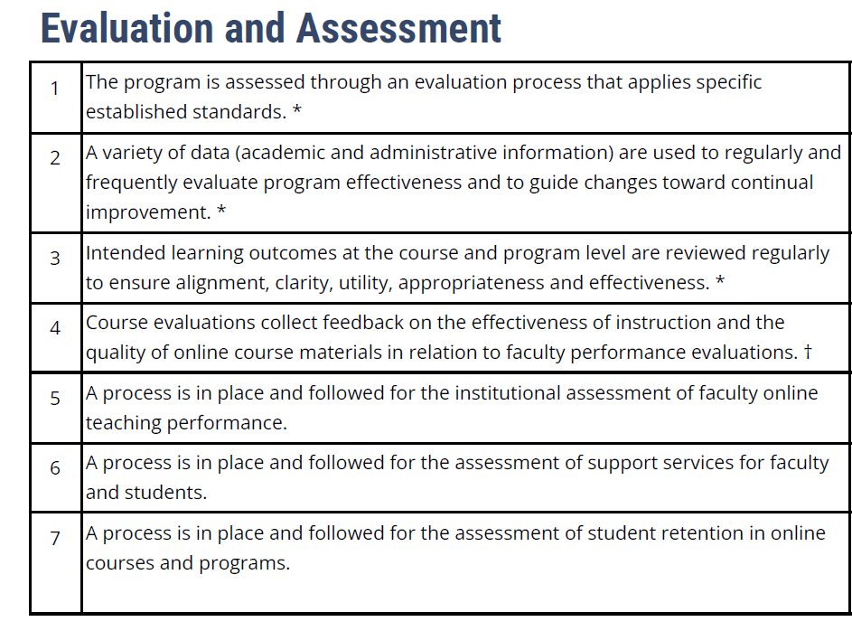
OLC Framework
Demonstrated alignment with Principles of Practice and SACSCOC guidelines
NOT an overhaul of the process/requirements & not req’d to look at ALL the data each year
To provide a foundation for quality and ensuring the process is in alignment with the university’s goals for DE

Slide 21
Future Reporting (AY24-25 & Beyond)
AY24-25: Addition of Compliance Indicators (Exemplary, Sufficient, Needs Improvement, Noncompliant)
AY25-26: To be launched in March ‘25; Forms will be more structured to solicit required information.
Both cycles:
--At least 2 data sources (PLOs & student experience)
--Evidence of continuous improvement based on the data
*23-24 Sources of Data still can be updated.

Slide 22
Resources
OIEE – assessment.tamu.edu
--DE Program Effectiveness information & resources
distance.tamu.edu – Policies & faculty resources
lms.tamu.edu – Teaching & learning, training & resources, LMS support
Principles of Good Practice
OLC Program Rubric – to be used in a modified capacity

Slide 23
Dr. Elizabeth Piwonka, Director, OIEE, ebpiwonka@tamu.edu
Dr. Alyce Odasso, Associate Director, OIEE, a.odasso@tamu.edu
Dr. Kelley Shaffer, Director of Distance & Digital Education, kshaffer2@tamu.edu

